Slide 1
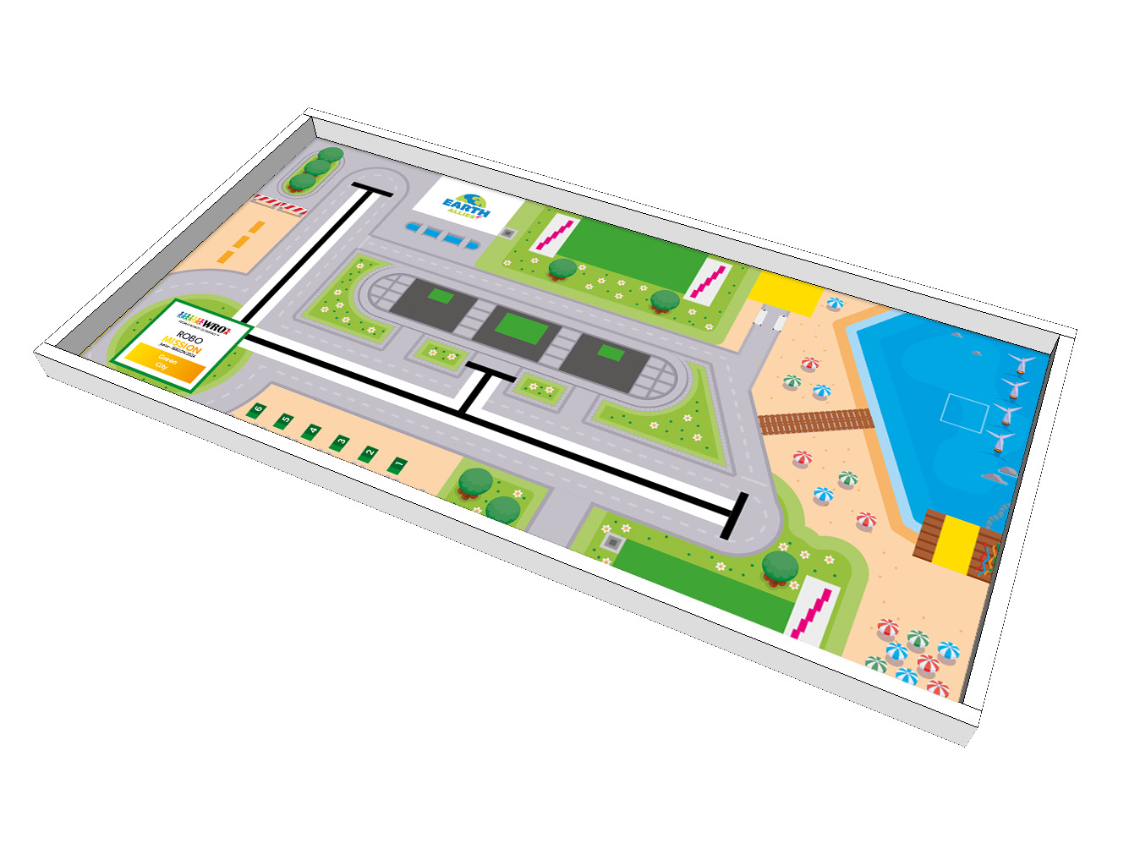
Green Starter Kits
Houses
Park A
Charging A
E-Bikes
Start Area
Park elements
Charging B
Park B
Fence

